Slide 1
Deep learning using Tensor flow
Pruthvij Thakar
Sumedh saraf
(TEAM 4)

Slide 2
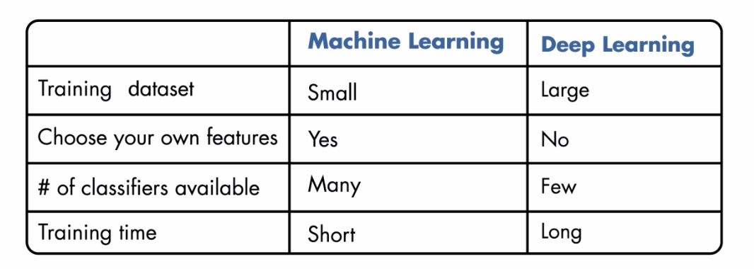
Machine Learning VS Deep Learning

Slide 3
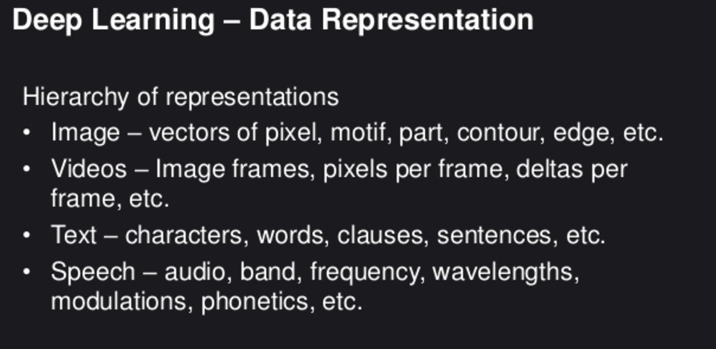
Data for deep learning

Slide 4
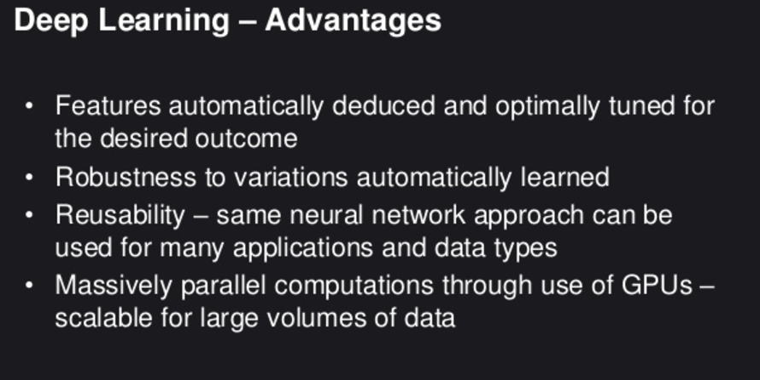
Advantages of deep learning

Slide 5
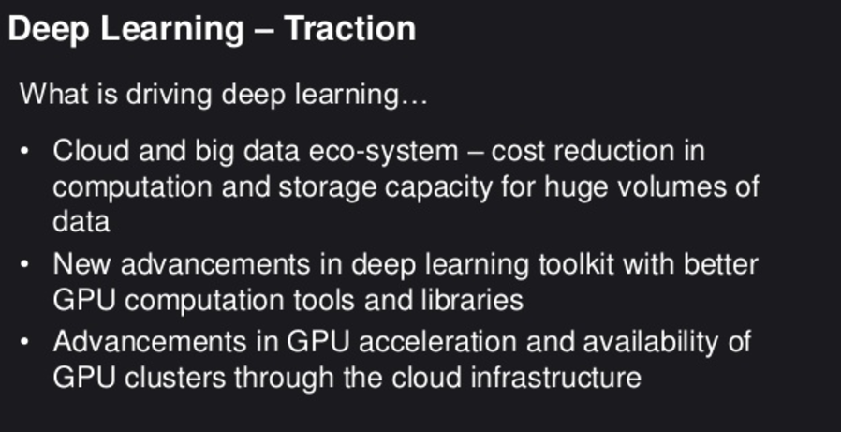

Slide 6
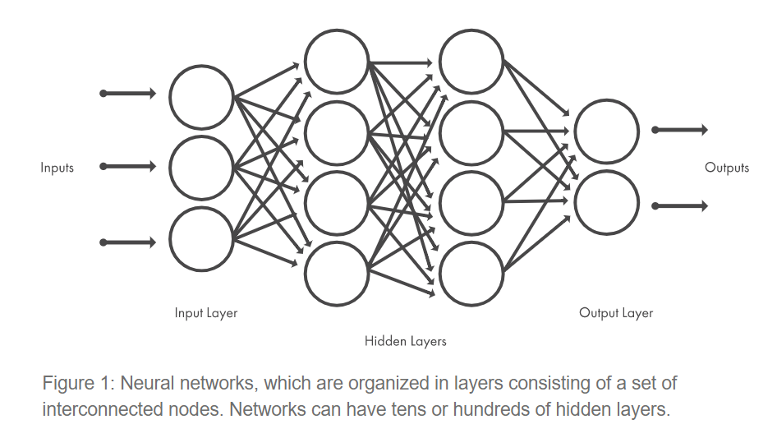
Neural networks

Slide 7
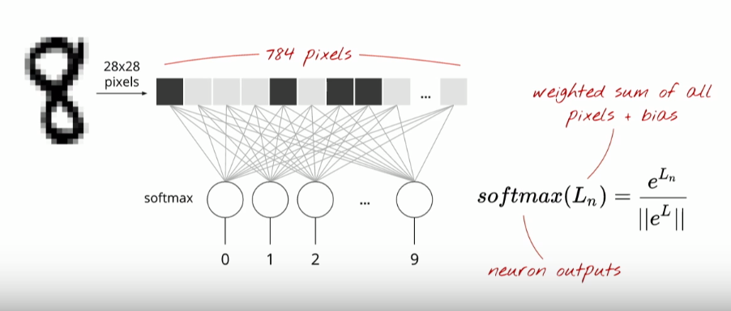
Basic ingredients for a deep learning model

Slide 8
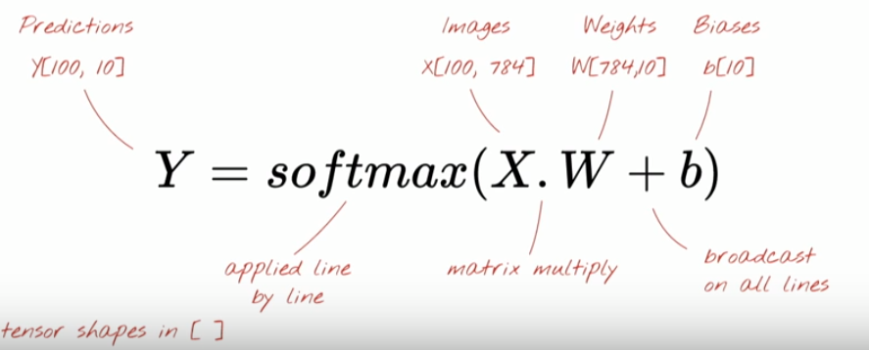
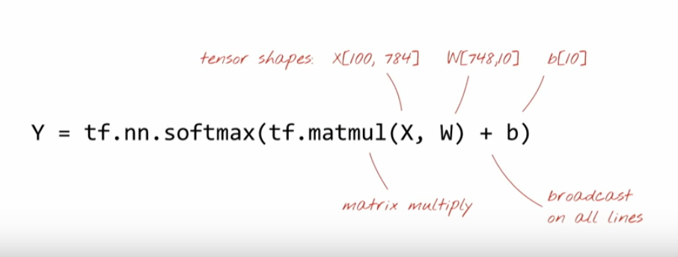
softmax

Slide 9
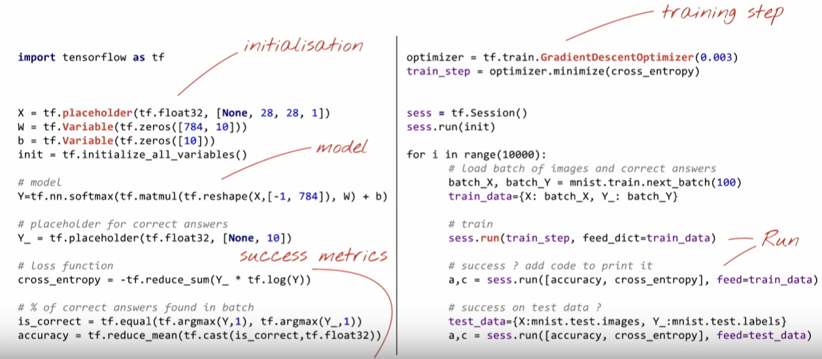

Slide 10
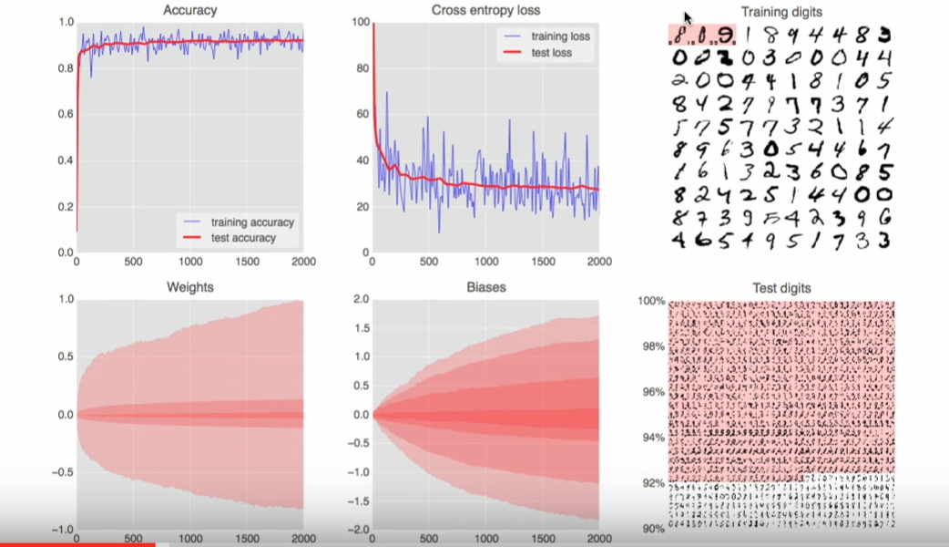

Slide 11
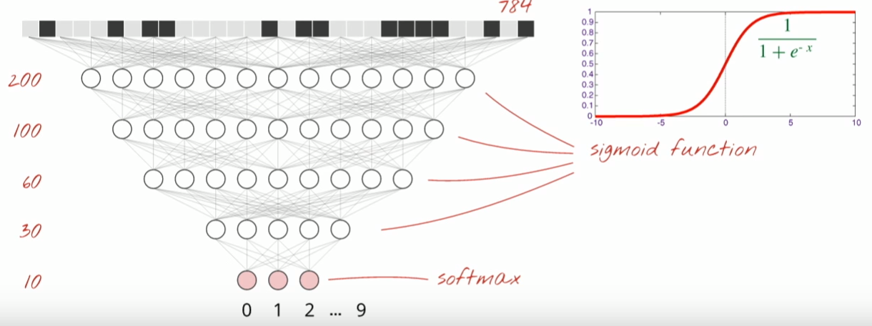
Go deep

Slide 12
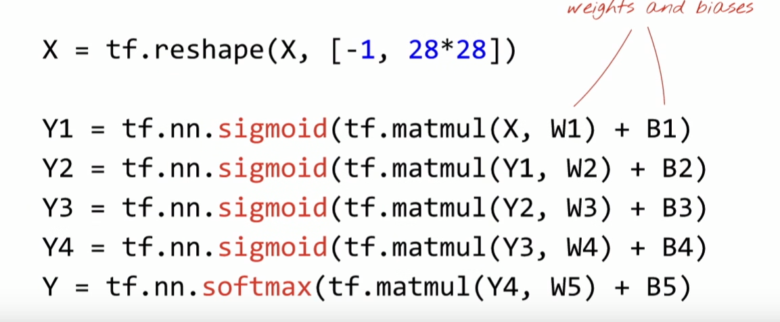
sigmoid

Slide 13
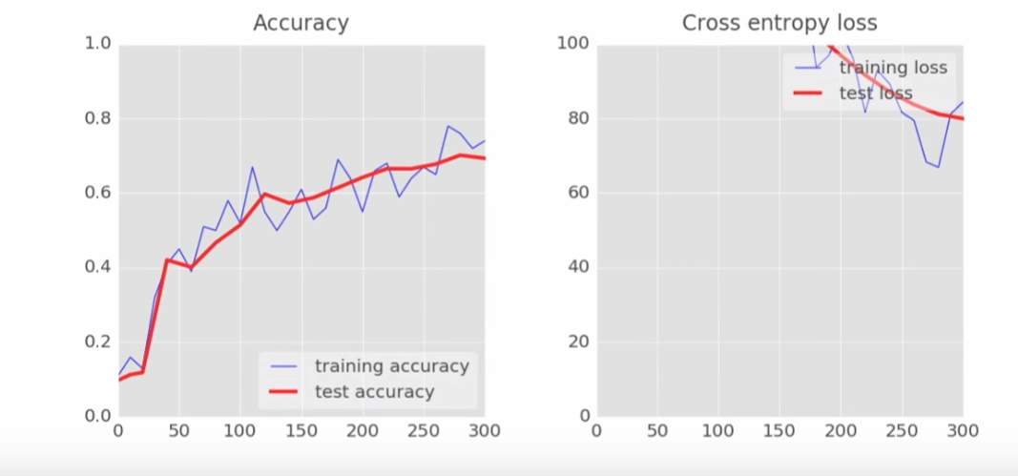
Performance graph

Slide 14
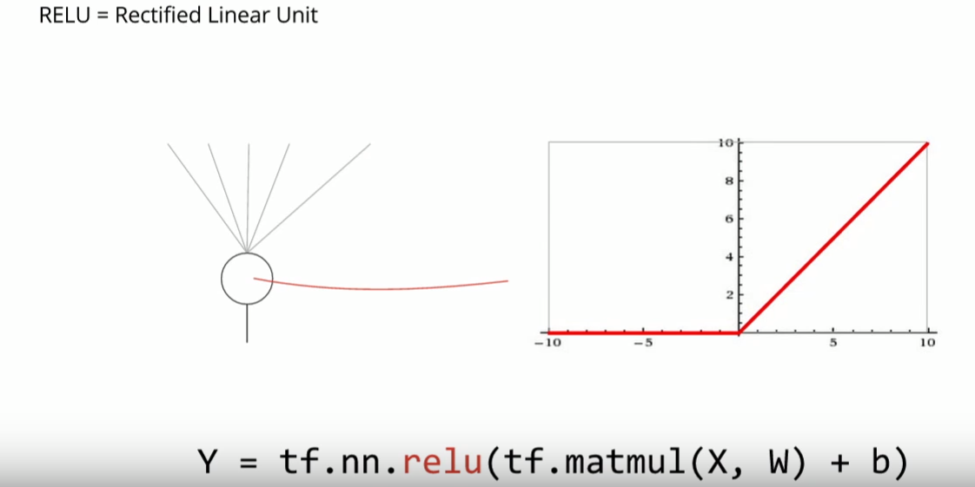
RELU

Slide 15
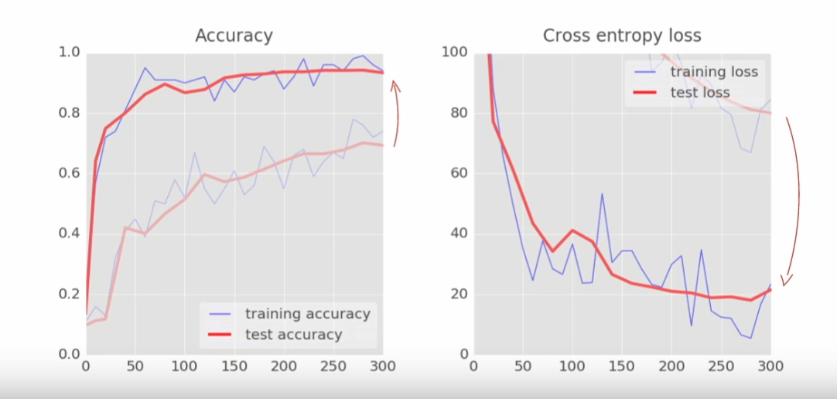
Relu performance

Slide 16
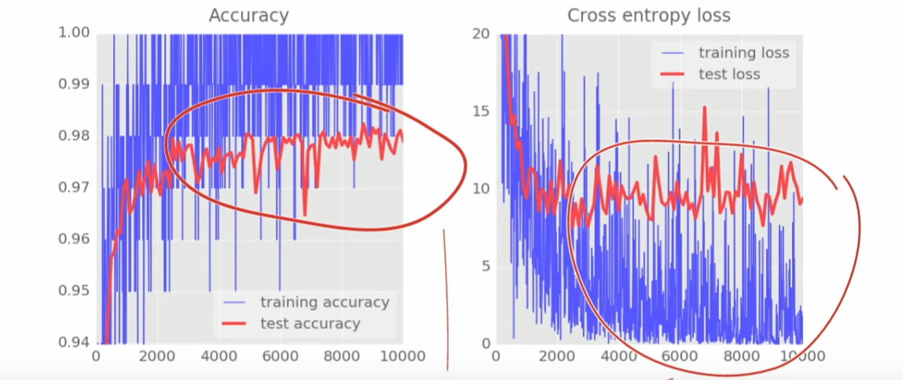
Relu noisy curve

Slide 17
Reasons of noisy curves
Going through the function too fast
Not reaching the bottom of the error function i.e. in thus case RELU
The trick is to go slow enough but how ?
If you go too slow you spend too much time on training.
Exponentially slow is the answer, START FAST & GRADUALLY SLOW DOWN
Mathematically called DECAYING LEARNING RATE

Slide 18
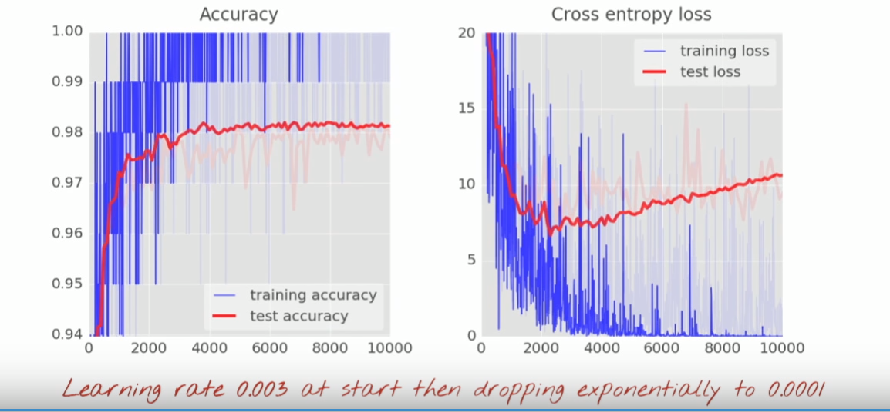
After adding exponential decay rate

Slide 19
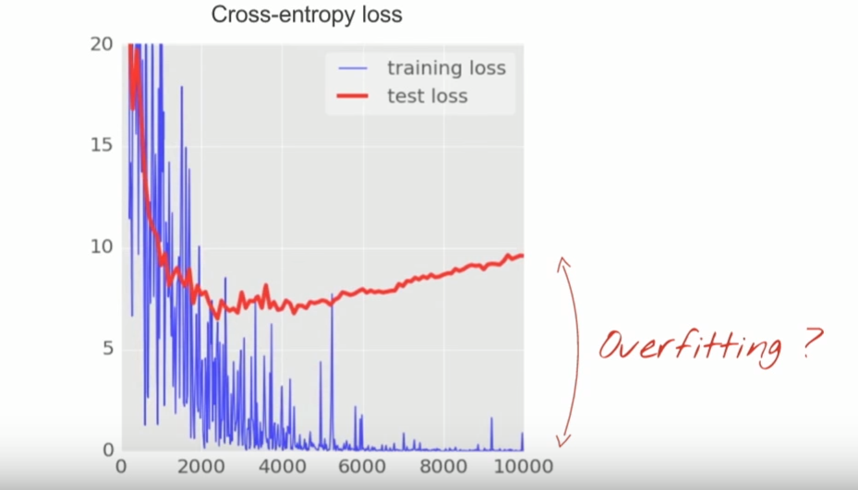
STILL ONE PROBLEM ?
When Lambda in any function(in our case its ENTROPY) is too small it causes Overfitting
When Lambda is too Large it causes UnderFitting
REMEDIES?
REGULARIZATION
(DROPOUT)

Slide 20
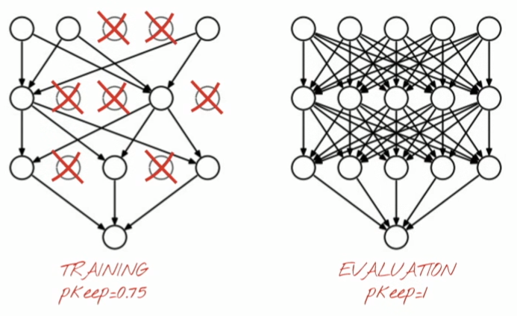
DROPOUT

Slide 21
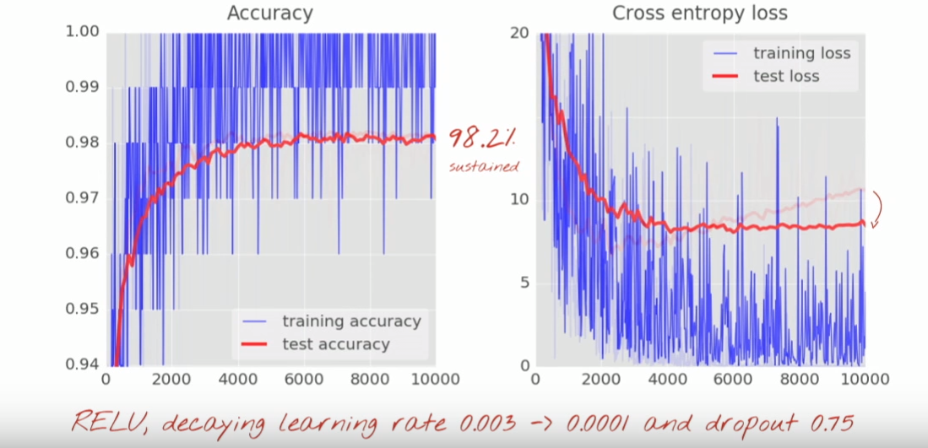
DROPOUT PERFORMANCE

Slide 22
WHAT WENT WRONG?
Remember in the starting phase we flattened all the Pixels to analyze the images and to test and train it?
This causes a heavy loss of information, The information about shapes, curves, edges and many such details are lost which make the images distinct from each other.
What Now ?
CNN

Slide 23
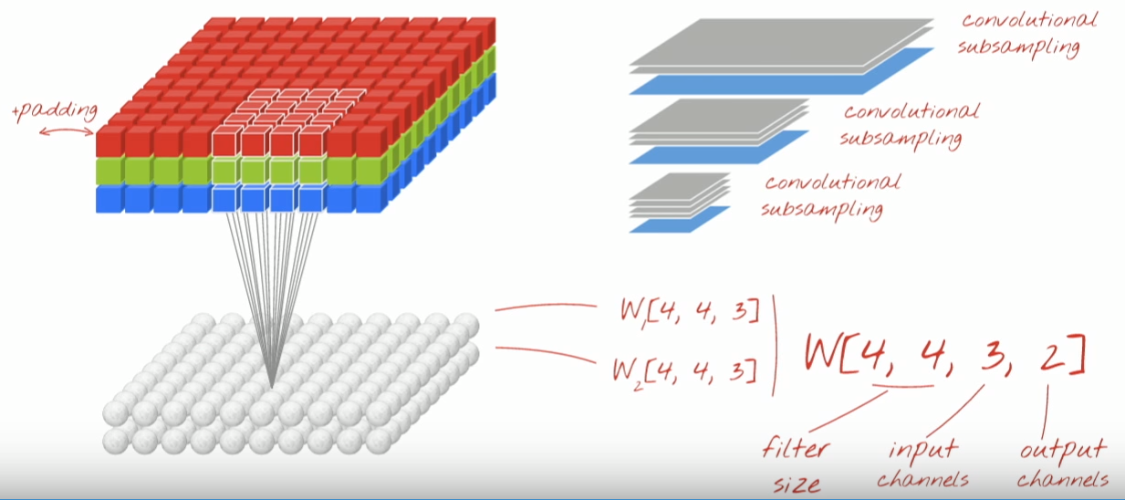
Convolutional neural network

Slide 24
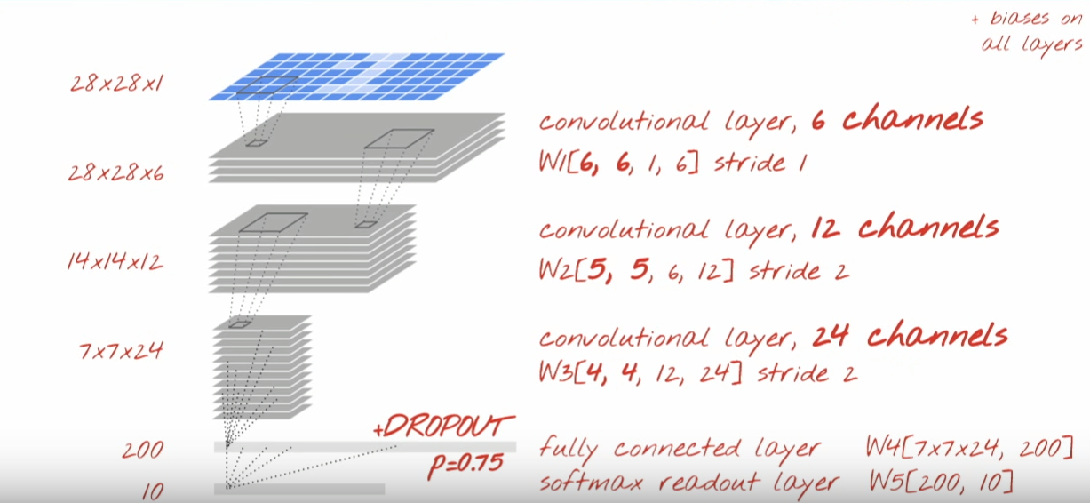
Structure of our cnn

Slide 25
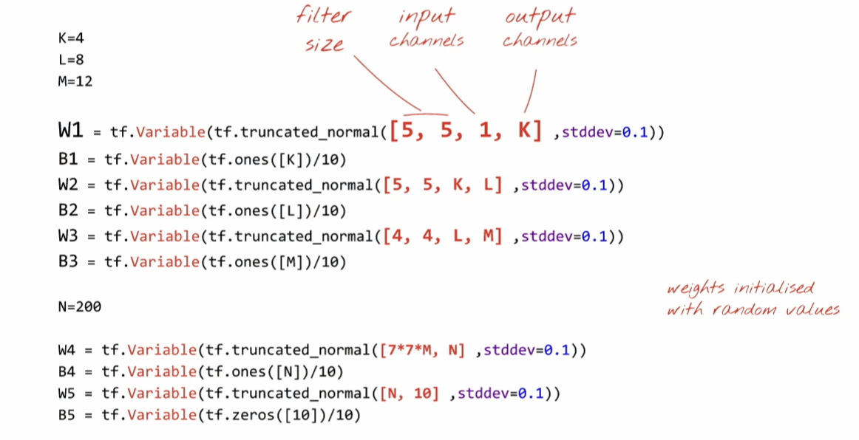
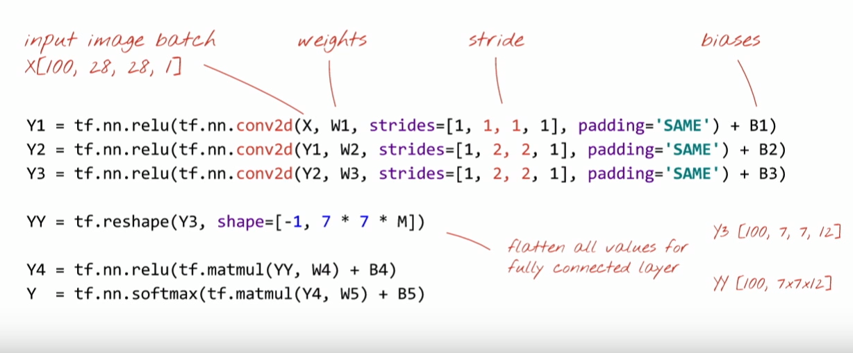

Slide 26
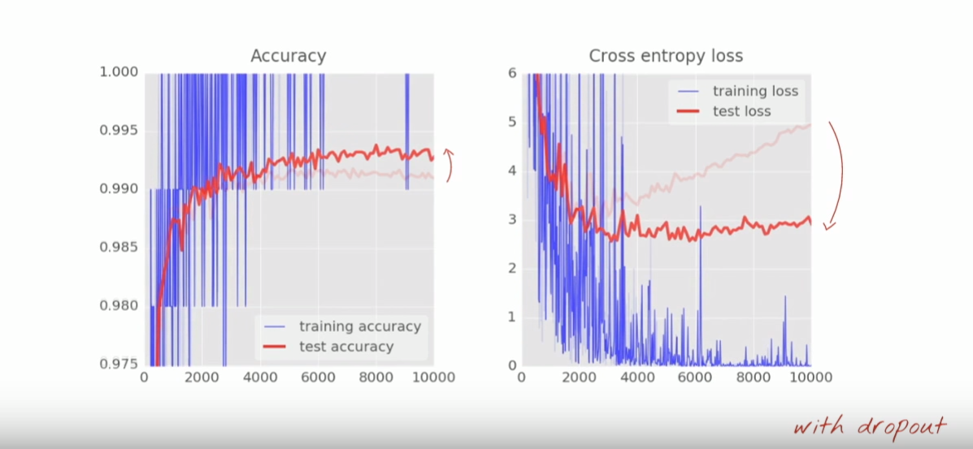
Final performance

Slide 27
DEMO

Slide 28
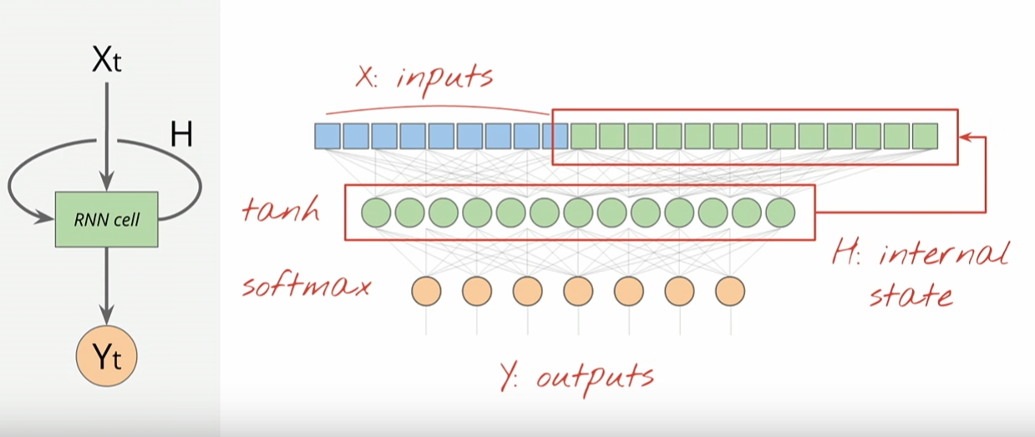
Other widely used deep neural network ?
RNN (recurrent neural network)

Slide 29
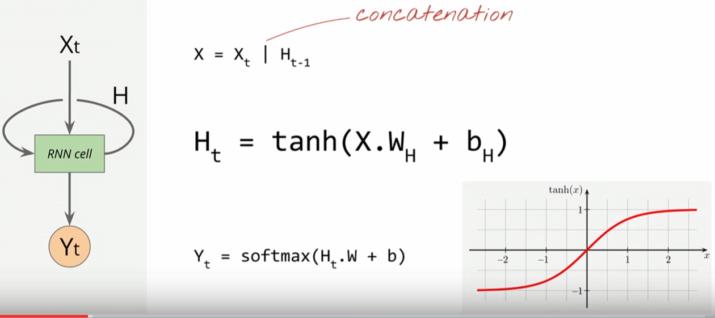
taN H

Slide 30
Importance of tan h as activation function
In truth both tanh and logistic functions can be used. The idea is that you can map any real number ( [-Inf, Inf] ) to a number between [-1 1] or [0 1] for the tanh and logistic respectively. In this way, it can be shown that a combination of such functions can approximate any non-linear function. Now regarding the preference for the tanh over the logistic function is that the first is symmetric regarding the 0 while the second is not. This makes the second one more prone to saturation of the later layers, making training more difficult.

Slide 31
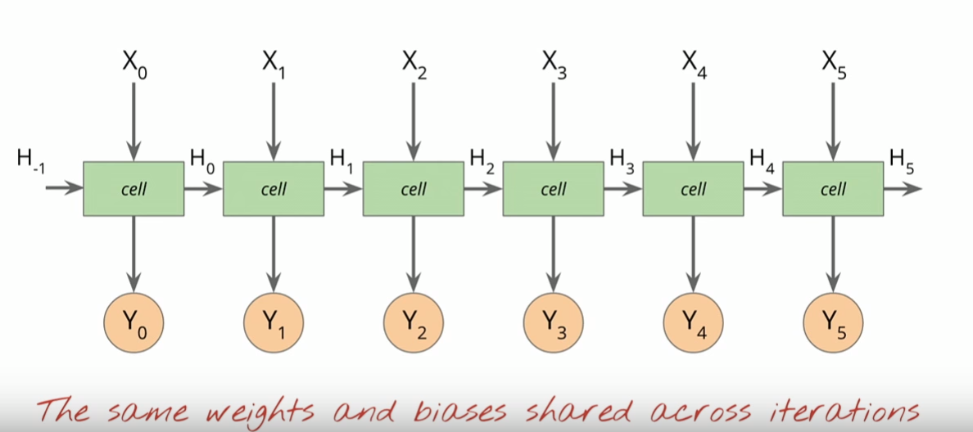
Simplified rnn

Slide 32
Challenges in rnn
The RNN tend to form a very deep neural network because of each cell passing through a neuron, SO if we have an input of 50 words it will form a 50 neuron deep network causing it to concatenate the output of previous layer and current input to be the new combined input.
The problem with neural network going too deep is that they tend not to converge resulting in a problem mathematically called vanishing gradient problem where gradient tends to be 0 and we use gradient to be the solution of the problem so it wont work.

Slide 33
Thank you

Slide 34
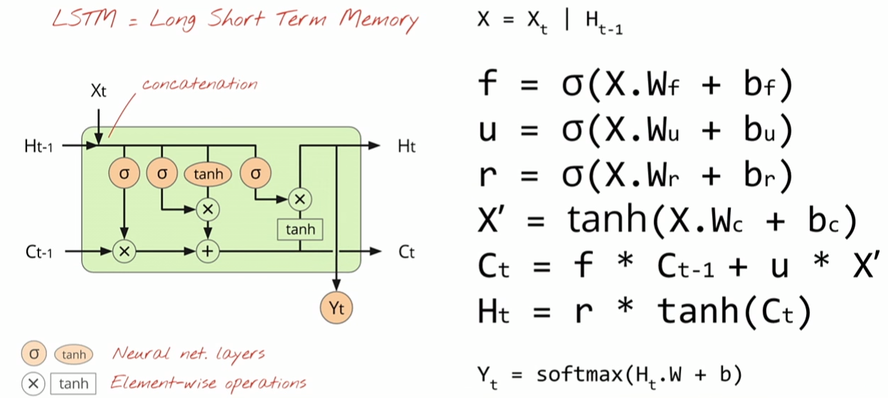
Solution : lstm

Slide 35
